Slide 1

C PROJECT BATCH

Slide 2


CHAPTER 1
CODE BLOCKS BASICS
Topics Covered
What Is Code Blocks ?
Why Not To Use Turbo C++ ?
Differences With Turbo C++
Configuring Code Blocks
Running A C Program In Code Blocks
Creating Our Own Header Files
Adding Support For “conio.h” In CodeBlocks

Slide 3
What Is Code Blocks ?
Code::Blocks is a free, open-source cross-platform IDE
(not a compiler) which was designed to support C
and C++ languages.
However now it also supports other languages like Fortran and D.

Slide 4
Which Compiler Code::Blocks Uses ?
Code::Blocks supports multiple compilers like:
GCC,
MinGW,
Digital Mars,
Microsoft Visual C++,
Borland C++,
LLVM Clang,
Watcom,
LCC and
the Intel C++ compiler.

Slide 5
What Are GCC And MinGW ?
GCC stands for GNU Compiler Collection, and is a collection of programming compilers including C, C++, Objective-C, Fortran, Java, and Ada.
It’s latest version is GCC 8.2 lauched on 26th –Jul-2018
MinGW stands for Minimalist GNU for Windows.
It is GCC compiler for Windows platform

Slide 6
About Turbo C++
Turbo C++ was released on somewhere between
1990-1992 (almost 27 years ago).
Back then it was a very good IDE and it was used
a lot to code C and C++.
But things have changed today in 2019

Slide 7
What Is Wrong With Turbo C++ ?
OutDated Compiler :
Turbo C++ uses a old 16-bit compiler which is outdated
and is not in compliance with the latest standards,
while the latest compilers are 32-bit or 64-bit and comply
to the standards.
Thus many applications built using Turbo C++ are not
compatible with our 64 bit OS.
No AutoComplete :
Another problem is that Turbo C++ does not support
autocomplete features which is really helpful on longer
projects and in minimizing errors related to syntax.
In Turbo C++ we will have to write every bit of code and
we will have to close every single function.

Slide 8
So What Are The Alternates ?
Today we have numerous IDE’s available
which can be used to migrate from Turbo C++ .
Some popular of them are:
Code Blocks
Dev C++
Code Lite
C-Free
Microsoft Visual Studio
Apple’s X-Code
We will be using Code Blocks in this project batch

Slide 9
Turbo C++ V/s Code Blocks
1. No “conio.h” Present
There's no header file named as 'conio.h' in
Code Blocks. Including such header file would
result in compilation error.
Since conio.h header file doesn't exist, the
latest standard does not support functions
like clrscr(), getch(), getche(), gotoxy() etc.

Slide 10
Turbo C++ V/s Code Blocks
So how do we clear the screen then?
We don't need to. Because whenever we will run the application , Code Blocks automatically launches a
fresh console window to display the output

Slide 11
Turbo C++ V/s Code Blocks
What if we want to clear the screen during execution of our application ?
If we want to clear the screen during runtime then we have to use the function system( ) available in the header file <stdlib.h>
The statement will be:
system(“cls”);

Slide 12
Turbo C++ V/s Code Blocks
What about getch( )?
As mentioned , getch( ) is not supported . However we have 2 alternates to it :
We can use system(“pause”)
We can use the function _getch( )

Slide 13
Turbo C++ V/s Code Blocks
2. No “dos.h” Present
There's no header file named as ‘dos.h' in Code Blocks.
And so we cannot call the functions like delay( )
But we have an alternate to this also, which the
function Sleep() available in the header file
“windows.h”
The statement will be:
Sleep(1000);

Slide 14
Turbo C++ V/s Code Blocks
3. The main( ) function has return type int
The main( ) function has the default return type of int
Just like C++ , here also we write return 0 as our last
statement in main( ) which indicates successful
termination
Although we can make it as void , but we will get a
warning during compilation :
warning: return type of 'main' is not 'int'

Slide 15
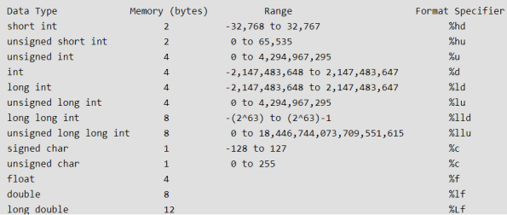
Data Types

Slide 16
Differences With TurboC++
In Turbo | In GCC
int | short int
unsigned int | unsigned short int
long int | int or long int
unsigned long int | unsigned int or unsigned long int
long double (10 B) | long double (12 B)
 | New Data Type: long long int (8B) and unsigned long long int(8B)
char , unsigned signed char , float and double are exactly same as Turbo C++

Slide 17
Differences With Turbo C++
What will be the output of the following code in Turbo ?
#include <stdio.h>
void main()
{
char ch=‘AB’;
printf(“%c”,ch);
}
Output:
A

Slide 18
Differences With Turbo C++
In CodeBlocks however this code will output B?
#include <stdio.h>
int main()
{
char ch=‘AB’;
printf(“%c”,ch);
return 0;
}
Output:
B

Slide 19
Differences With Turbo C++
What will be the output of the following code in Turbo ?
#include <stdio.h>
void main()
{
char ch=‘ABC’;
printf(“%c”,ch);
}
Output:
Syntax Error: character constants cannot be more than 2 characters long

Slide 20
Differences With Turbo C++
In CodeBlocks however this code will output C?
#include <stdio.h>
int main()
{
char ch=‘ABC’;
printf(“%c”,ch);
return 0;
}
Output:
C

Slide 21
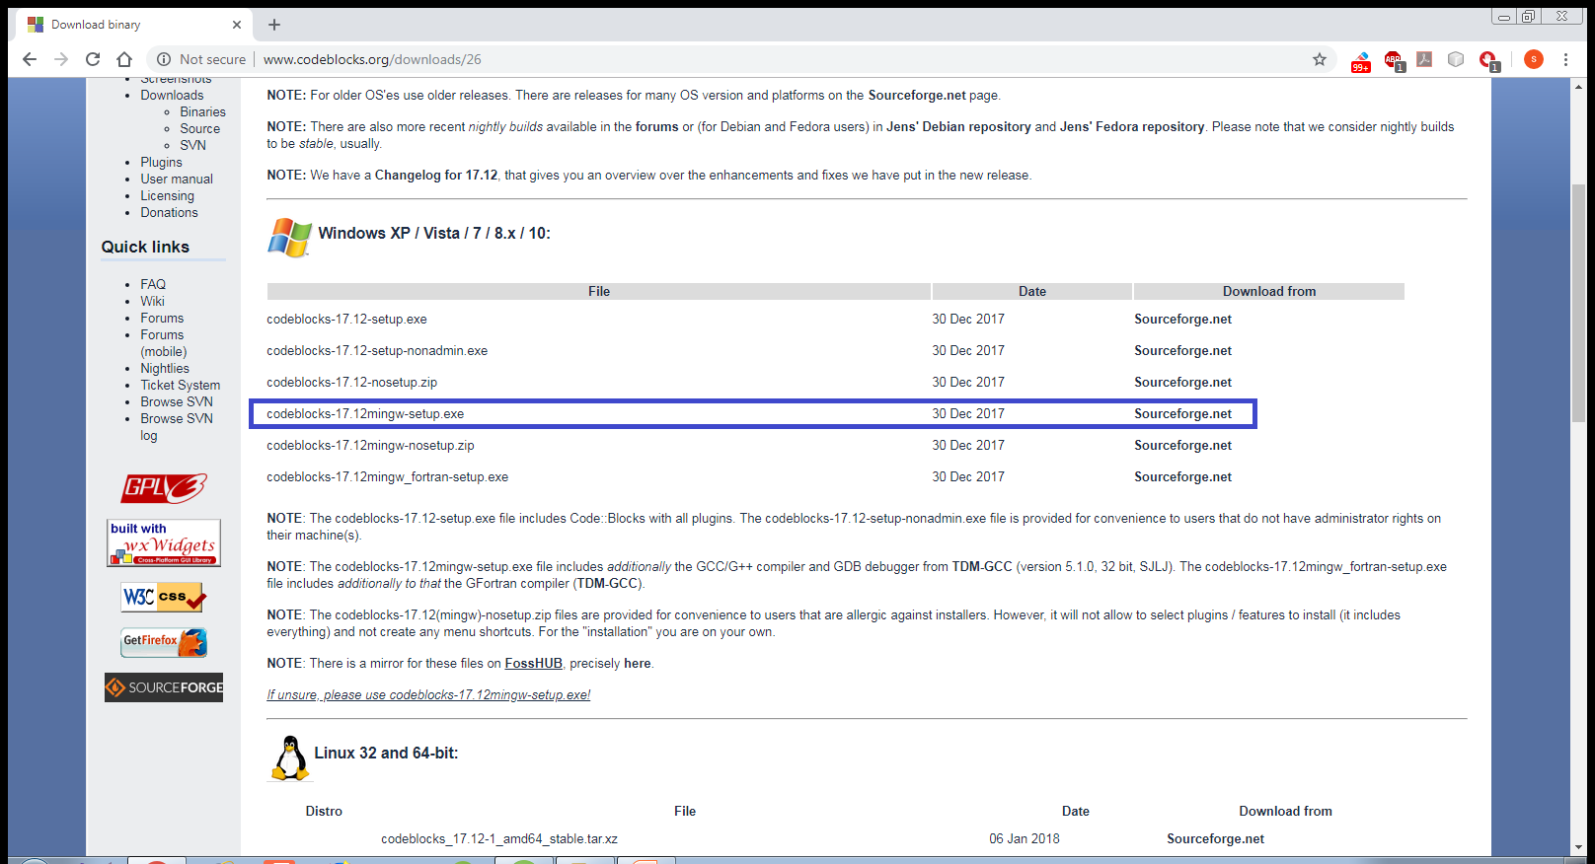
Downloading And Installing CodeBlocks
Open http://www.codeblocks.org/downloads/26
Click on CodeBlocks 17.02 mingw-setup.exe

Slide 22
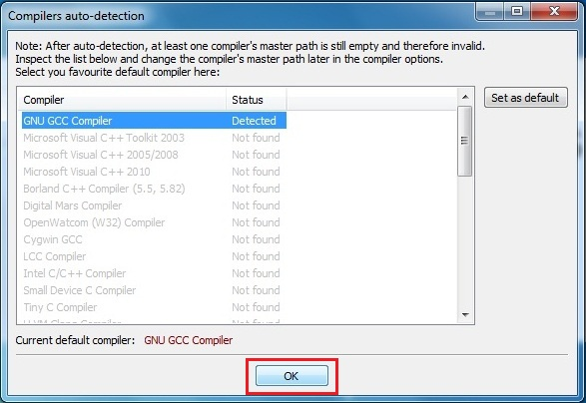
Downloading And Installing CodeBlocks
Now double click on downloaded installer.
The process is simple hit next couple of times.
Make sure installation path C:\Program Files\CodeBlocks (default location).
Now launch CodeBlocks

Slide 23
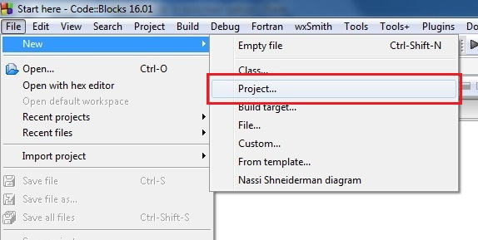
Developing First Application In CodeBlocks
Open CodeBlocks
Go to File –> New –> Project..

Slide 24
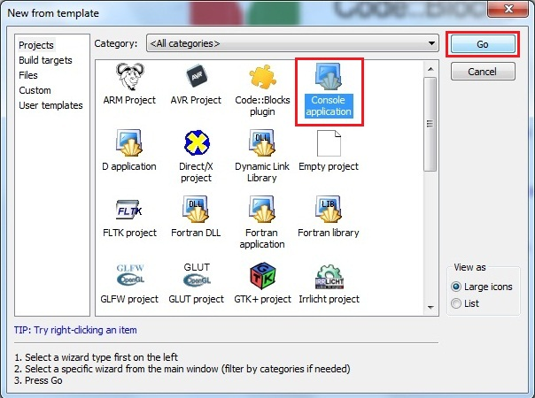
Developing First Application In CodeBlocks
Select Console application and hit on Go.

Slide 25
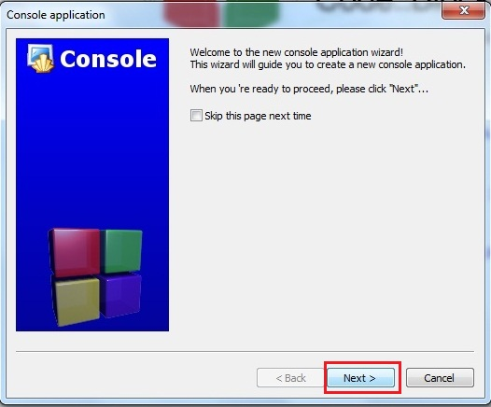
Developing First Application In CodeBlocks
Hit on Next

Slide 26
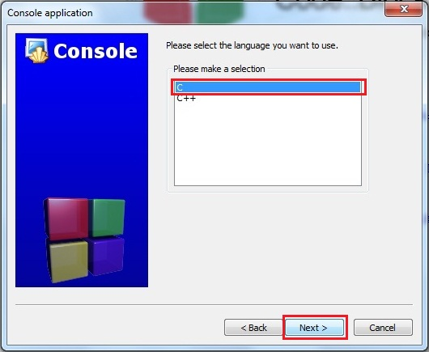
Developing First Application In CodeBlocks
Select C and click on Next

Slide 27
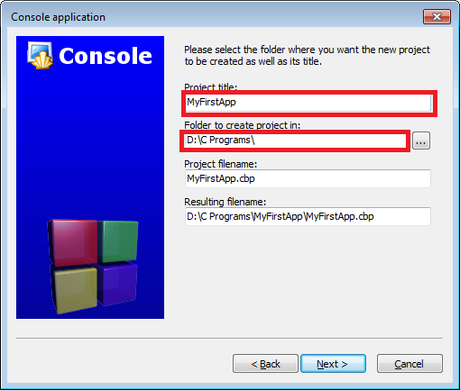
Developing First Application In CodeBlocks
Fill in the name of your Project( In CodeBlocks ,
every program is called a Project)
Also set the folder where you want to save
all your projects. In my case it is D:\C programs

Slide 28
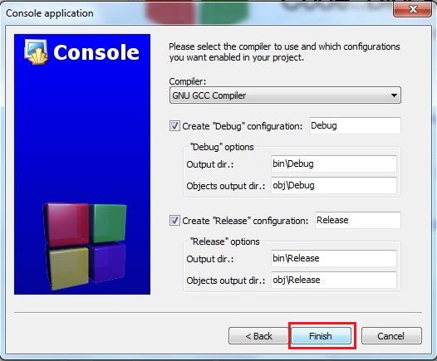
Developing First Application In CodeBlocks
Hit on Finish

Slide 29
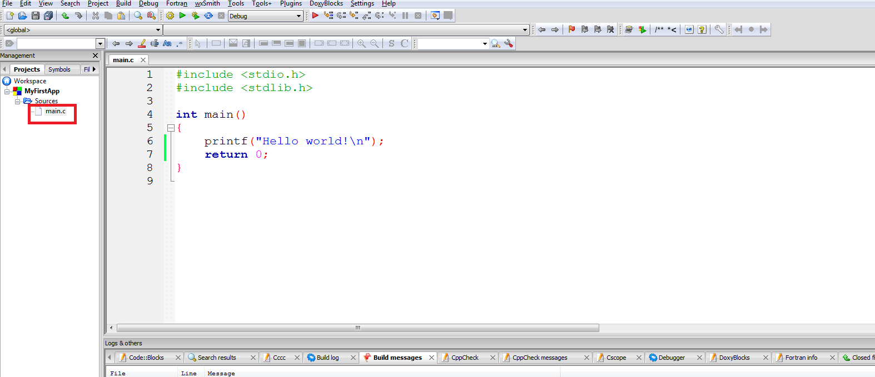
Developing First Application In CodeBlocks
CodeBlocks will automatically generate a file
called main.c shown in left pane under the
project name
You can now open the main.c file.
This entire code is automatically generated by CodeBlocks

Slide 30
Compiling And Running The Program
To compile the program, click Build → Build
To run the program, click Build→Run
Alternatively we can also select Build and Run
icon located in the toolbar on the top.
The icon has a yellow gear and a green play logo.

Slide 31
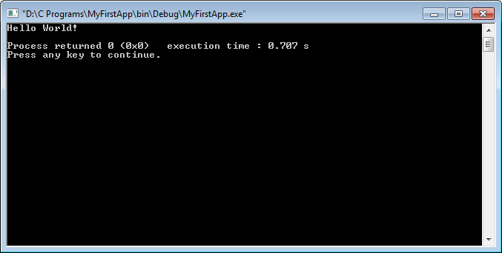
Compiling And Running The Program
Finally we will get the following output ,
as shown below.

Slide 32
Adding A New File
A project contains related files such as
source codes, header files, and relevant resources.
Although a project may contain many source files,
there can only be one main() function
among all the source files.

Slide 33
Adding A New File
That is, we cannot keep two programs (each having a main() function) in one project (we will get
the error "multiple definition of 'main'" when
we try to build the project).
We need to create one project for each program.
However , there is a solution to this , but first we
will learn how to add a new file/program to our
project

Slide 34
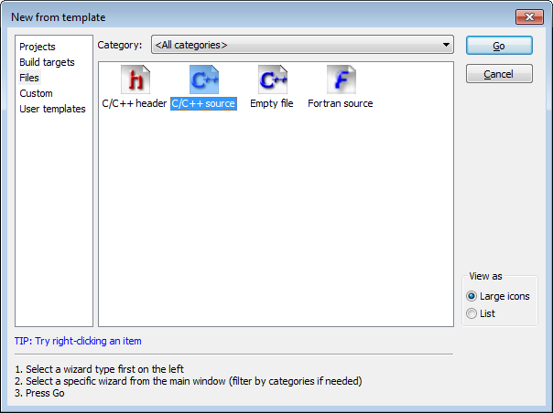
Adding A New File
Select C/C++ Source from the window that appears

Slide 35
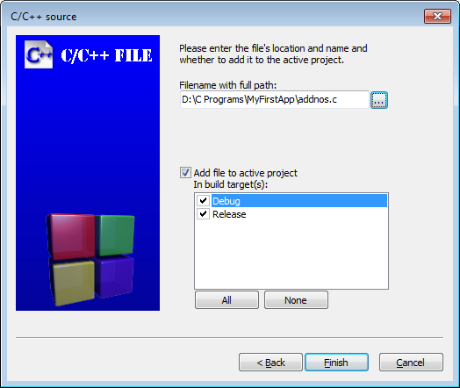
Adding A New File
Continue through the following dialogs very
much like the original project creation and
select C when prompted for a language.
On the final page, we will have to mention the
new filename and location. We have given
the name addnos.c

Slide 36
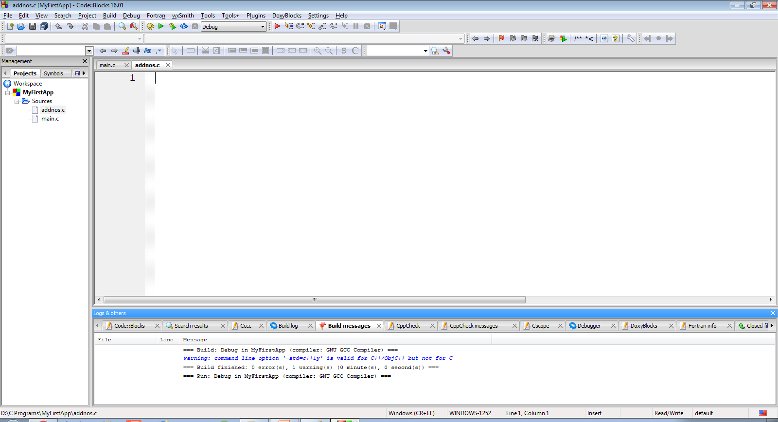
Adding A New File
Doing this will add a blank file called addnos.c
to the project MyFirstApp

Slide 37
Writing The Code
Let’s add the code to find sum of 2 integers
inputted by the user:
#include <stdio.h>
int main()
{
int a,b,c;
printf("Enter 2 int:");
scanf("%d %d",&a,&b);
c=a+b;
printf("Nos are %d and %d",a,b);
printf("\nTheir sum is %d",c);
return 0;
}

Slide 38
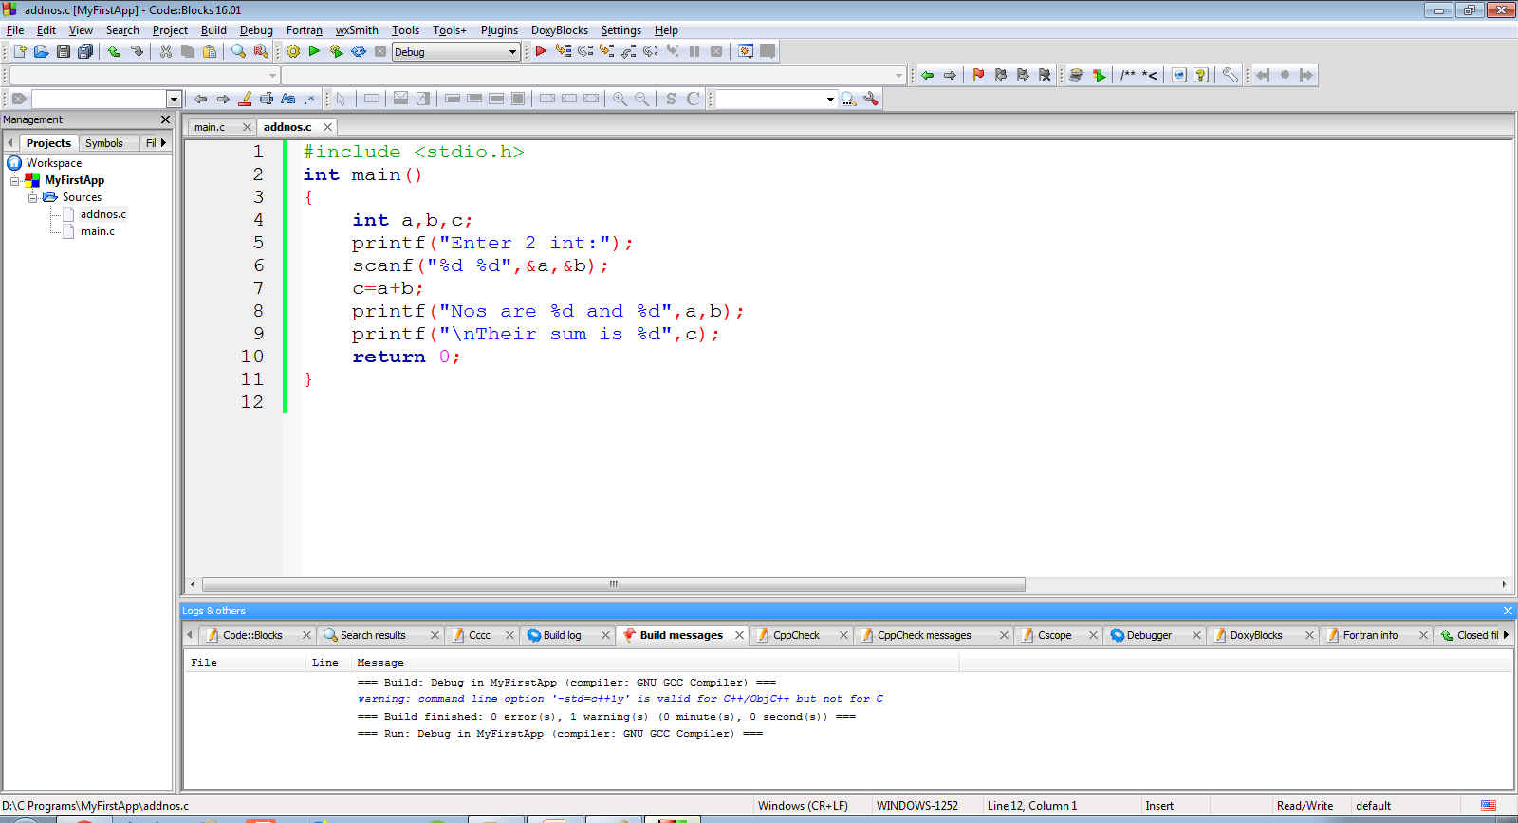
Writing The Code
The screenshot of the code is as below

Slide 39
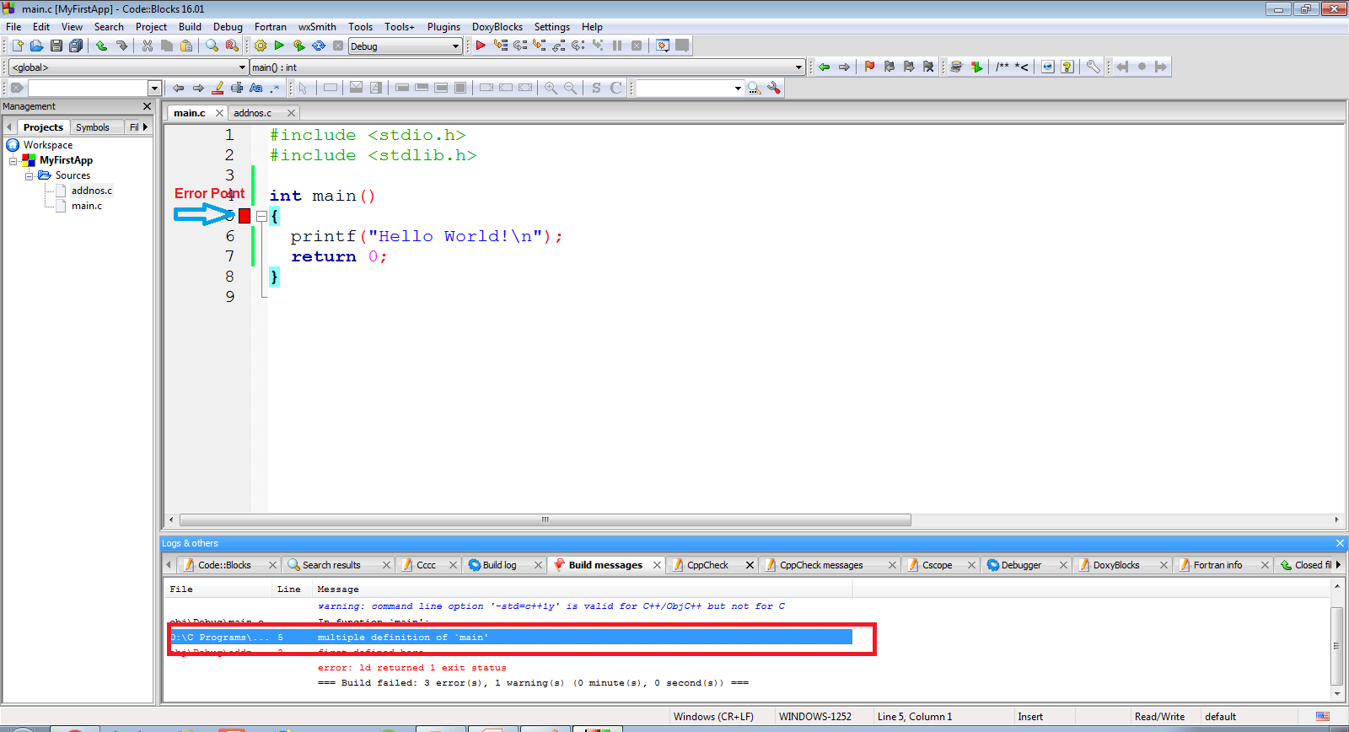
Multiple main( ) Error !
Now , when we will compile the code , we will
get the error “multiple definition of `main’ ”

Slide 40
Reason And Solution !
This is because our project contains 2 files
(main.c and addnos.c) and both have the
main( ) function
To solve this problem , we can remove main.c
from the project .
The removed files are not deleted and remain
in the folder

Slide 41
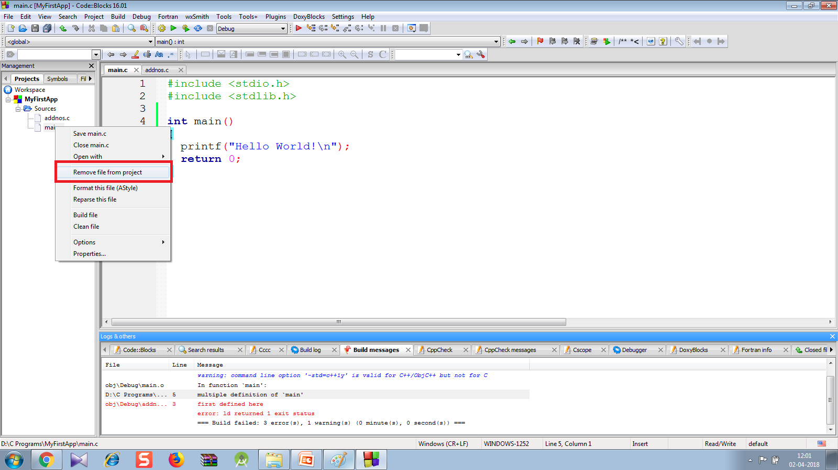
Solution
To remove main.c , right-click on “main.c" ⇒ "remove file from project".

Slide 42
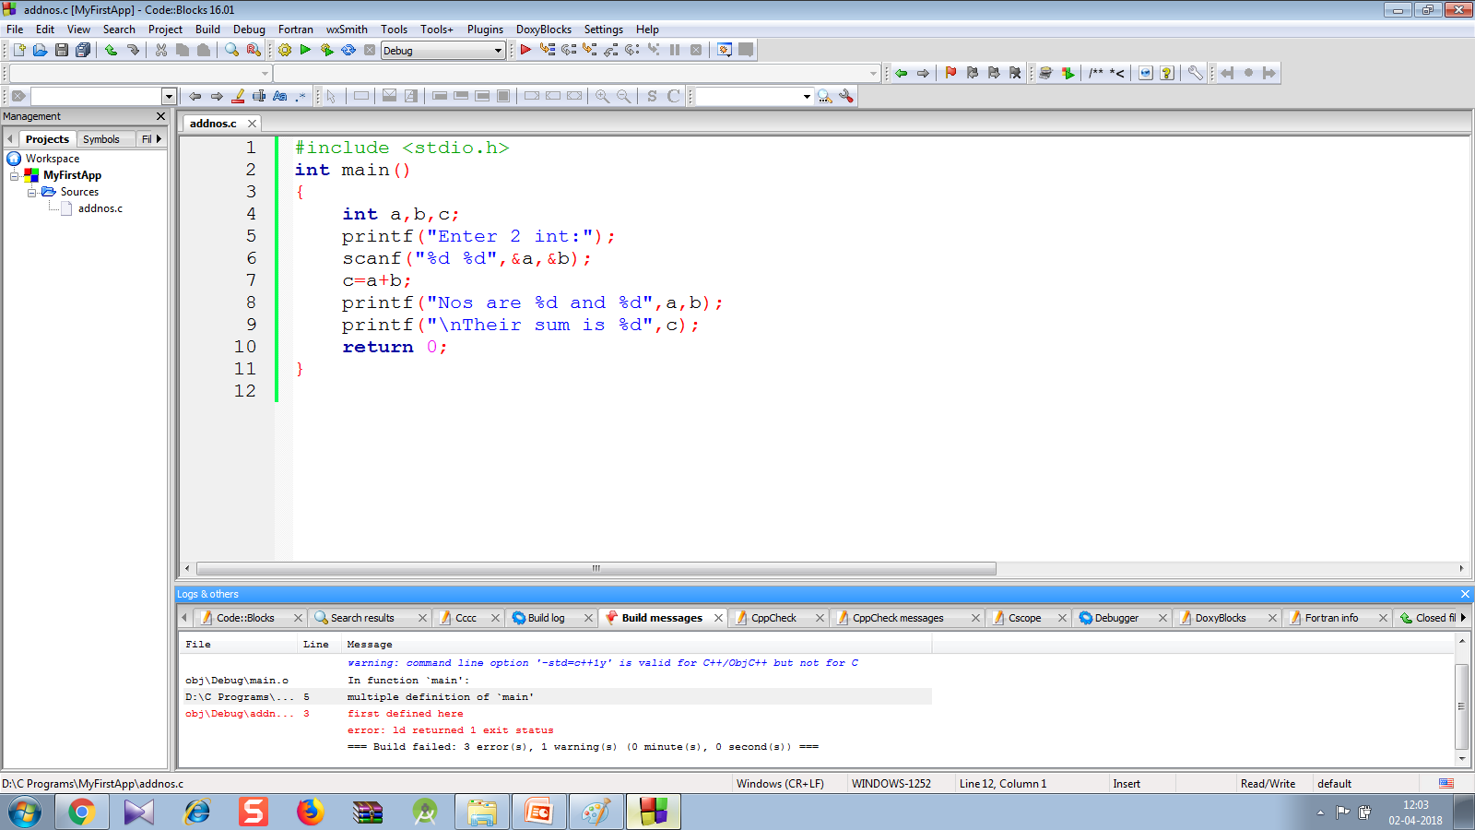
Error Removed !
Now we will only have 1 file with main( ) function i.e. addnos.c so the code will compile and run

Slide 43

Output
Following is the output shown by the code

Slide 44
Creating Programmer Defined Header File
CodeBlocks , makes it very simple to create our own header files containing declaration of our own functions.
It is a 3 step process:
First we create our own header file containing function prototypes
Then we define these functions in a separate .c file
Finally we call these functions from our main( ) function

Slide 45
Creating Programmer Defined Header File
To do this follow the below mentioned steps:
Create a new project called MySecondApp
Follow the previous steps which will add a file called main.c in our project containing the main( ) function

Slide 46
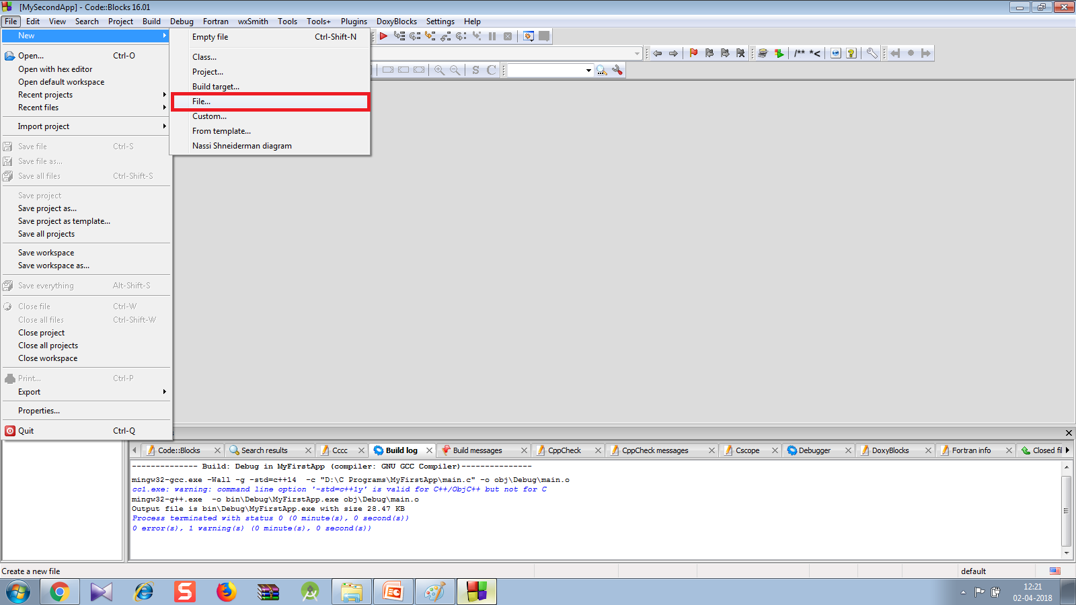
Creating Programmer Defined Header File
Now select File menu →New→File

Slide 47
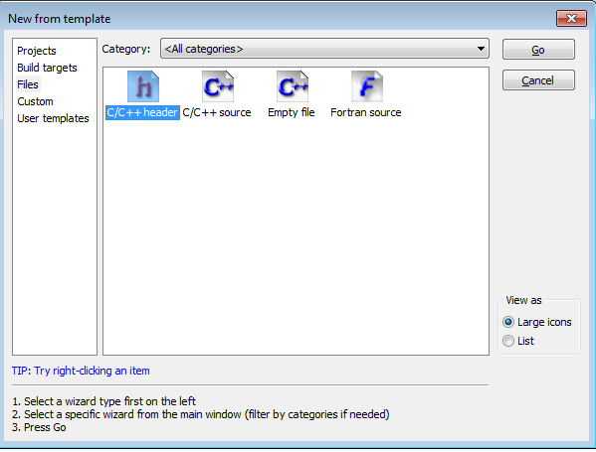
Creating Programmer Defined Header File
From the window that appears , select C/C++ Header and select Go

Slide 48
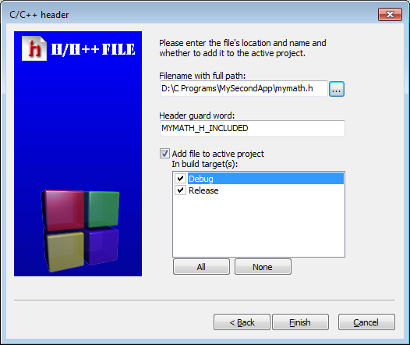
Creating Programmer Defined Header File
In the next window type the header file name as mymath.h after selecting the location and click on Finish
Also select debug and release options

Slide 49
Creating Programmer Defined Header File
After this we will get the header file by the name mymath.h with a default header guard code
We will also get a new element called Headers added to our project containing the header file mymath.h
The screenshot is on next page

Slide 50
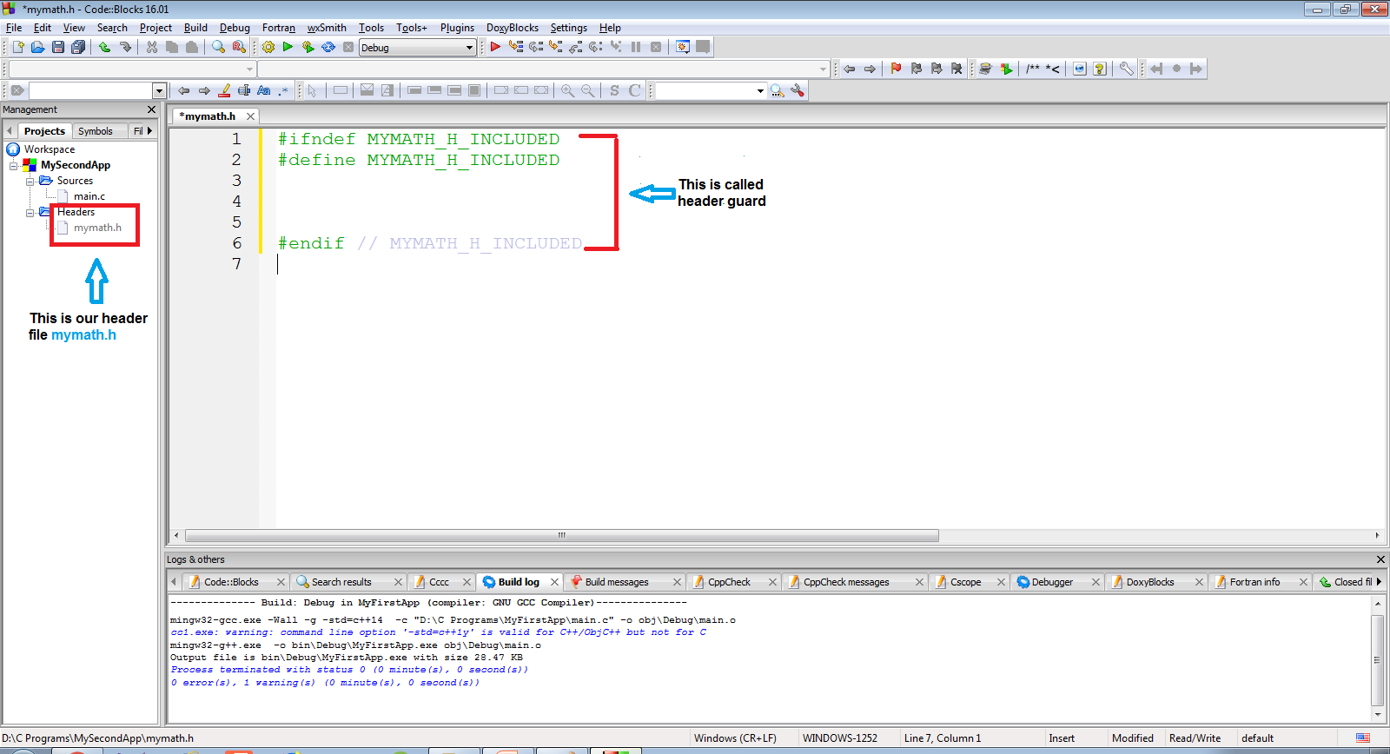
Creating Programmer Defined Header File

Slide 51
Creating Programmer Defined Header File
Now we will have to declare the prototype of the functions we want to keep in this header file.
Let’s create a function called add( ) in this header file
#ifndef MYMATH_H_INCLUDED
#define MYMATH_H_INCLUDED
void add(int,int);
#endif

Slide 52
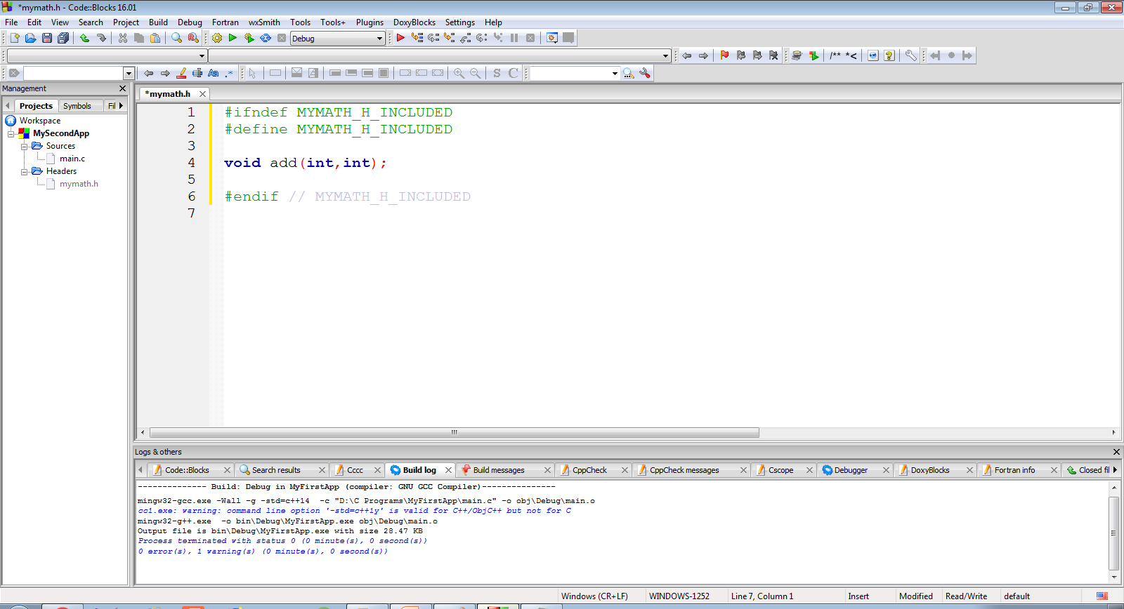
Creating Programmer Defined Header File

Slide 53
Creating Programmer Defined Header File
Now after declaring the function prototype , our next job is to define the function in a separate .c file
For this , as before select File menu →New→File

Slide 54
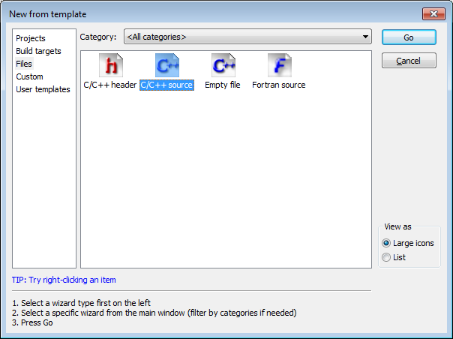
Creating Programmer Defined Header File
From the window that appears , select C/C++ Source and select Go

Slide 55
Creating Programmer Defined Header File
Select C and click on Next

Slide 56
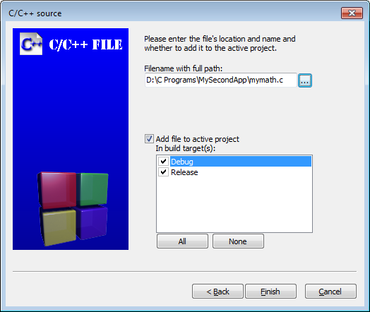
Creating Programmer Defined Header File
In the next window , as before provide the name and location of the file and hit Finish
For example ,in this app we have named it mymath.c

Slide 57
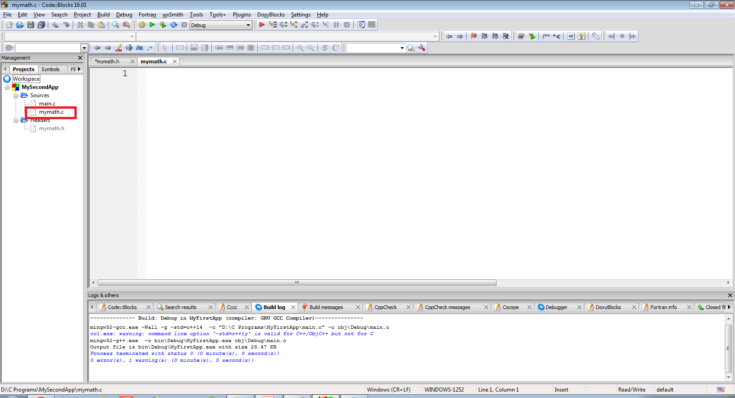
Creating Programmer Defined Header File
Doing this will add a blank file called mymath.c to the project MySecondApp

Slide 58
Code Of mymath.c
Let’s add the definition of the function add( ) in the file mymath.c
#include <stdio.h>
void add(int a,int b)
{
int c;
c=a+b;
printf("Nos are %d and %d",a,b);
printf("Their sum is %d",c);
}
We have to attach the header file <stdio.h> because we are calling the function printf( ) here in this code

Slide 59
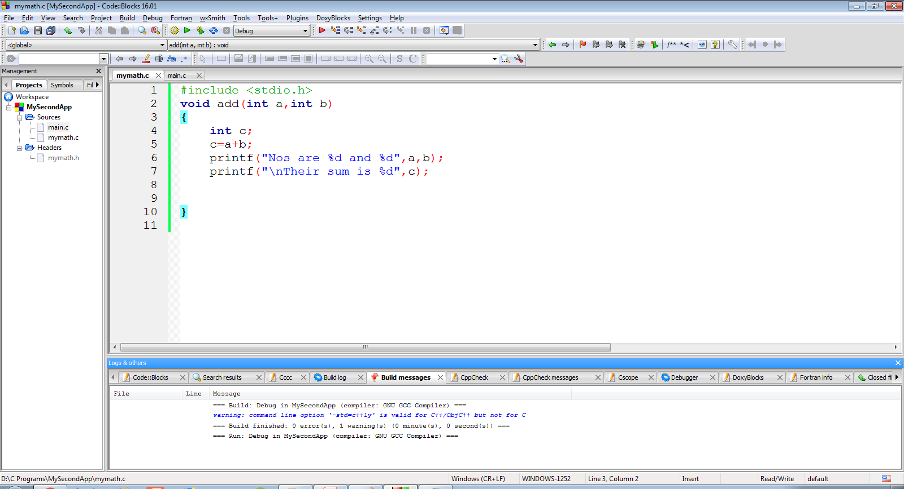
Creating Programmer Defined Header File

Slide 60
Creating Programmer Defined Header File
Finally we will have to update the file main.c by doing the following changes in it:
Include the header file “mymath.h” along with <stdio.h>
In function main( ) accept input from the user and call the function add( ) appropriately

Slide 61
Code Of main.c
#include <stdio.h>
#include "mymath.h"
int main()
{
int a,b;
printf("Enter 2 int");
scanf("%d %d",&a,&b);
add(a,b);
return 0;
}

Slide 62
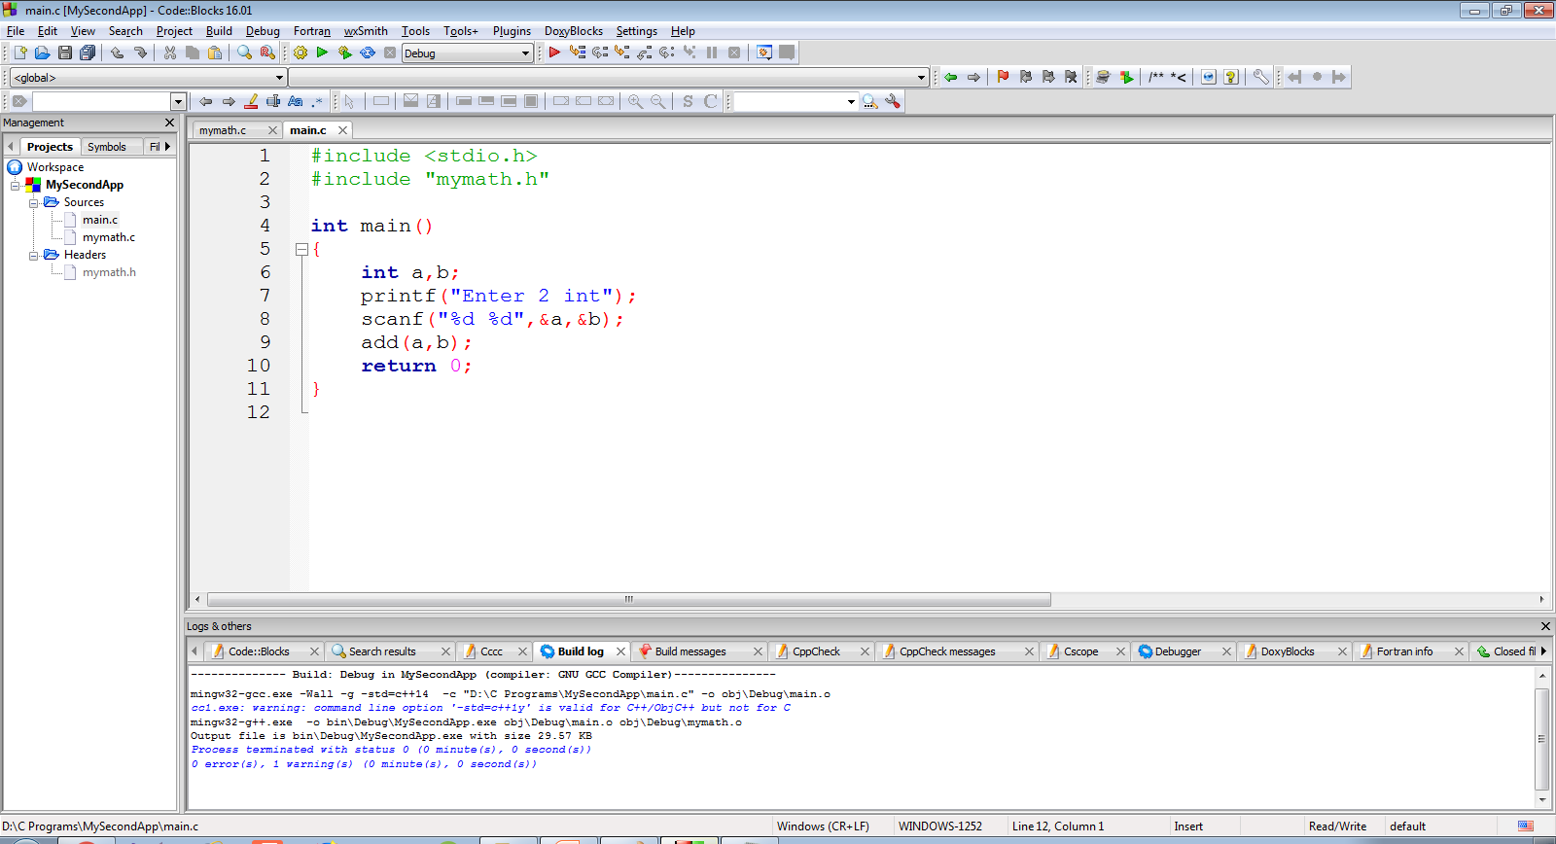
Code Of main.c
The screenshot of the code is as below

Slide 63

Output
Following is the output shown by the code

Slide 64
Adding conio.h To CodeBlocks
CodeBlocks/gcc don’t natively support conio.h.
However , there is an implementation of conio.h for gcc as a third party library.
This implementation can be downloaded from
https://sourceforge.net/projects/conio/
This link will give us a file called conio21.zip

Slide 65
Adding conio.h To CodeBlocks
After extracting conio21.zip , we will get 2 files called
conio2.h and conio.c
Copy and paste conio2.h and conio.c in our Project Folder
Now open the project in CodeBlocks by selecting File→Open and selecting the Project File from the Workspace Folder

Slide 66
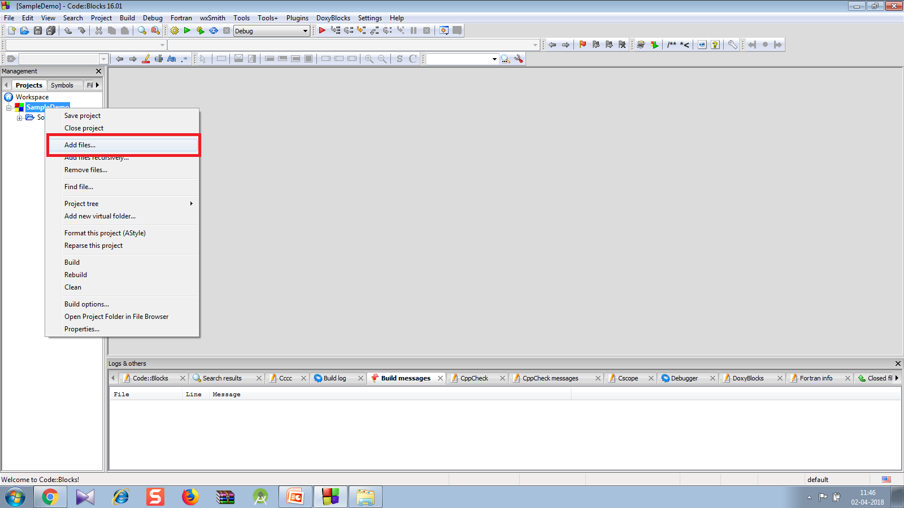
Adding conio.h To CodeBlocks
Now right click the Project in Workspace in the left pane and select Add Files

Slide 67
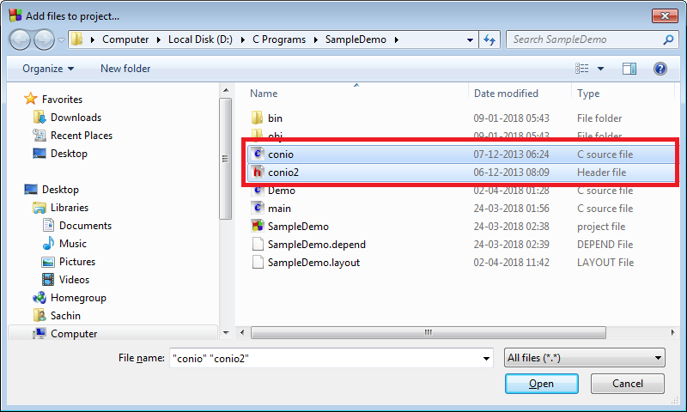
Adding conio.h To CodeBlocks
In the window that opens , select the files conio2.h and conio.c

Slide 68
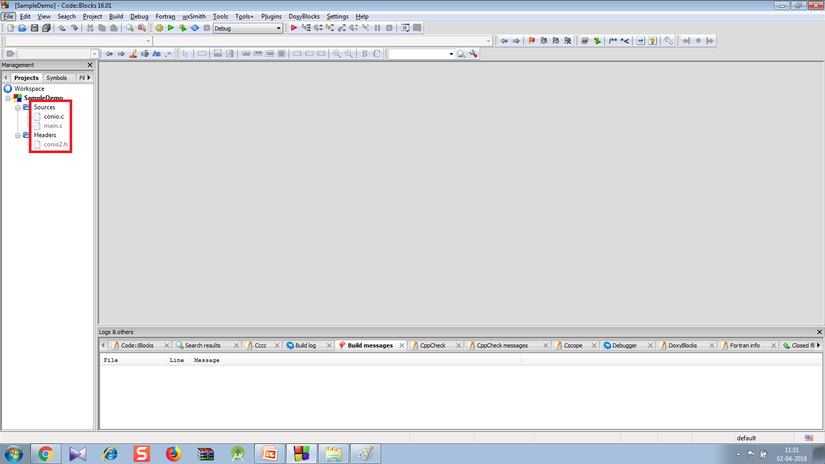
Adding conio.h To CodeBlocks
Doing this will automatically place conio2.h in Headers and conio.c in Sources

Slide 69
Adding conio.h To CodeBlocks
Now open the source file “main.c” and add the statement #include “conio2.h”.
Now we can use all the functions which are present in conio.h in Turbo C++ like clrscr( ), textcolor( ), gotoxy( ) etc
#include <stdio.h>
#include "conio2.h"
int main(){
gotoxy(40,12);
printf("Hello");
textcolor(GREEN);
gotoxy(40,13);
printf("Bye");
getch();
return 0;
}

Slide 70
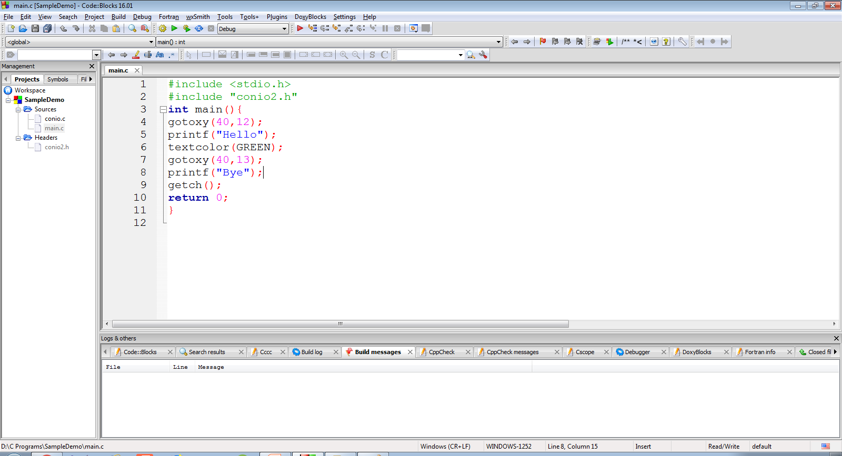
Adding conio.h To CodeBlocks

Slide 71
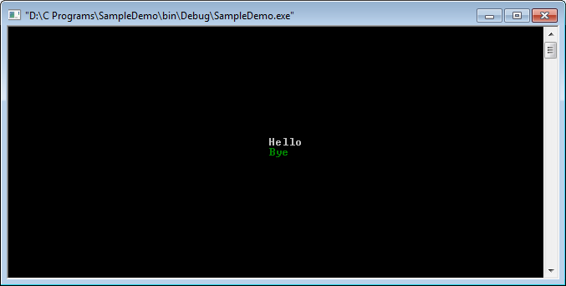
The Output

